Slide 1
INTEGRITYX SQUAD
TEAM MEMBERS : DHARANIDHARAN S
GOKUL KUMAR S
GOWTHAM G
JAHAN SAI J

Slide 2

INTEGRITYX SQUAD
DEEP FAKE DETECTION
Develop an advanced deepfake detection tool targeting various creation methods like Faceswap and Neural Voice Puppetry. Utilize a multimodal approach, ensuring robustness against adversarial attacks and a user-friendly interface. Address challenges posed by diverse tools and limited law enforcement understanding. Incorporate MesoNet for effective video analysis and employ spectral analysis and deep learning for audio deepfake detection.

Slide 3
INTEGRITYX SQUAD
Misinformation and Fake News:
DEEPFAKE
HAZARDS
Deepfakes can be used to create convincing false narratives, leading to the spread of misinformation and fake news.
Identity Theft and Privacy Concerns:
Deepfakes can be exploited for identity theft, as individuals' faces and voices can be manipulated without their consent, raising serious privacy concerns.
Political Manipulation:
Deepfakes can be used to manipulate political discourse by creating fabricated content, potentially influencing elections or public opinion.
Challenges for Law Enforcement:
Law enforcement faces challenges in detecting and addressing deepfake-related crimes, requiring ongoing training and technological advancements.

Slide 4
PROBLEM WITH EXISTING MODELS
LESS ACCURACY
UNI MODEL ANALYSIS
OUTDATED MODEL
LIMITED GENERALIZATION

Slide 5
SOLUTION

Slide 6
WORKING FLOW
INTERNET SCRAPPING
DEEPFAKE DETECTION
RELATED VIDEO ANALYSIS
STORAGE AND LOGGING
Utilize Data API for trending videos, extracting titles, descriptions, and tags.
Implement algorithm using pre-trained models, focusing on visual and audio analysis.
Gather tags from potential deepfake, use API or web scraping to find related videos.
Log video details for Deep Fake analysis, store information securely for comprehensive analysis and review

Slide 7
INTERNET SCRAPING
API Integration:
Integrate YouTube Data API for secure access to trending video details.
Data Retrieval:
Fetch metadata, including titles, descriptions, and tags.
Analysis:
Extract and analyze key information for insights.
Storage & Presentation:
Organize data, use databases, and create a user-friendly interface.

Slide 8
DEEPFAKE DETECTION USING MESONET
Transfer learning enables MesoNet to generalize well to new datasets, contributing to its effectiveness in identifying manipulated facial features.
Utilization of Convolutional Neural Networks (CNNs) for effective feature extraction.
Adversarial training involves exposing the model to generated adversarial examples, enhancing its resilience against sophisticated manipulation techniques commonly used in deep fake creation.
MesoNet's capacity for fine-grained analysis of facial micro-textures, enabling the detection of subtle anomalies introduced by manipulation.

Slide 9
HOW MTCNN WORKS WITH MESONET
MTCNN excels in detecting faces in images, providing precise bounding boxes around facial regions.
Accurate localization is crucial for deep fake analysis, as it sets the stage for detailed examination of facial features.
MesoNet is fine-tuned to perform detailed manipulation analysis specifically on the localized facial regions identified by MTCNN.
Results from MTCNN, including bounding boxes and landmarks, are integrated with MesoNet's manipulation analysis, providing a comprehensive understanding of the input content and enhancing overall detection accuracy.

Slide 10
RELATED VIDEO ANALYSIS
Gather tags from potential deepfake:
Extract tags associated with a potential deepfake video using
the YouTube API.
Find related videos:
Use the YouTube API or web scraping to find videos with
similar tags or criteria.
Ensure you comply with YouTube's terms of service regarding
API usage.
Apply deepfake detection to related videos:
Apply the same deepfake detection algorithm to the related
videos to identify potential deepfakes.

Slide 11


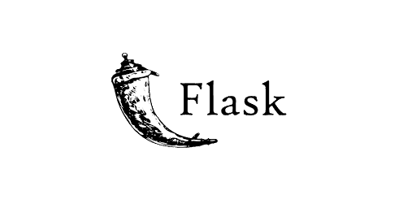
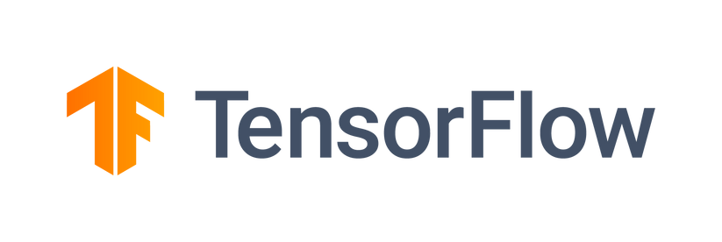


TECH STACKS USED

Slide 12
WHY PREFER OUR SYSTEM ?
01 - multimodal analsis
02 - high accuracy
03 - cross method deep fake
detection
04 - related video analysis

Slide 13
LIMITATIONS
Resource Intensiveness
Computational Complexity
Collaborative Approches

Slide 14
FUTURE IMPLEMENTATION
SPATIOTEMPORAL ANALYSIS
META LEAERNING
DETECTING DEEPFAKE ACROSS MULTIPLE SOCIAL MEDIA
FACIAL X RAY DETECTION

Slide 15
THANK YOU

